Slide 1


RETAIL STORE ANALYTICS
Turning Data into Actionable Insights for Retail Excellence

Slide 2
Content:
Customer Insights
Order Analysis
Product Performance
Payment Analysis
Status Tracking
Revenue Trends
JOINs
Aggregation
HAVING
Date functions
Subqueries
Ranking
SQL Queries and Insights along with
Key SQL Techniques

Slide 3
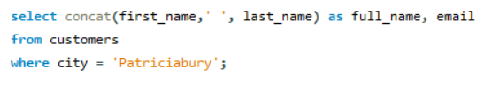
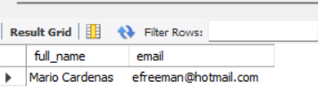
01.
Retrieve the full names and email addresses of all customers who live in city 'Patriciabury'.

Slide 4
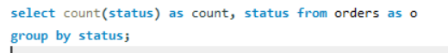
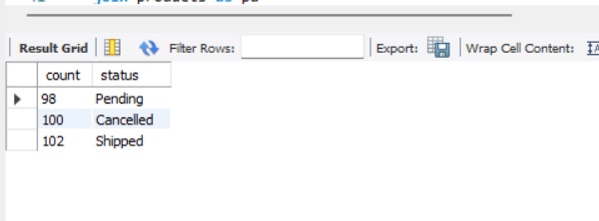
02.
Count the number of orders by their status (e.g., pending, shipped, completed) and display the result.

Slide 5
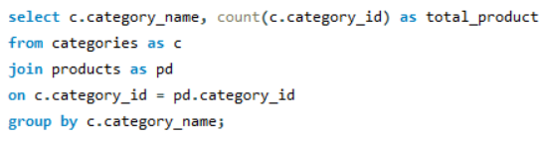
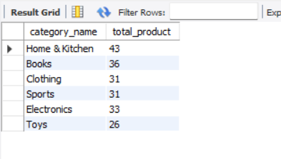
03.
Retrieve the number of products available in each category.

Slide 6
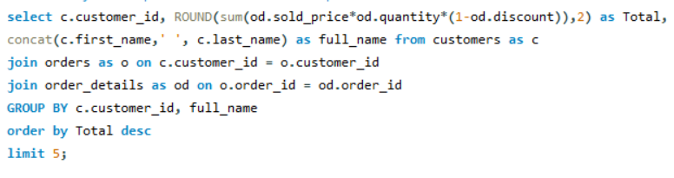
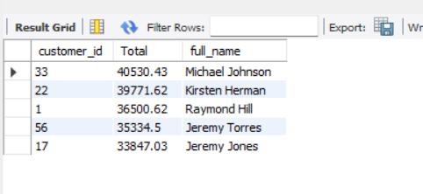
04.
Identify the top 5 customers who have spent the most on orders.

Slide 7
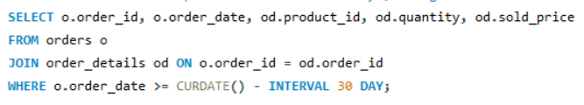
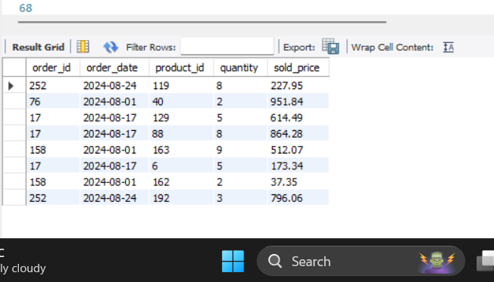
05.
Retrieve all orders placed in the last 30 days, along with the order details. orders.

Slide 8
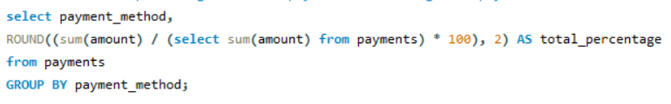
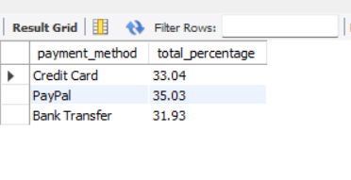
06.
Calculate the percentage of total payments made using each payment method.

Slide 9
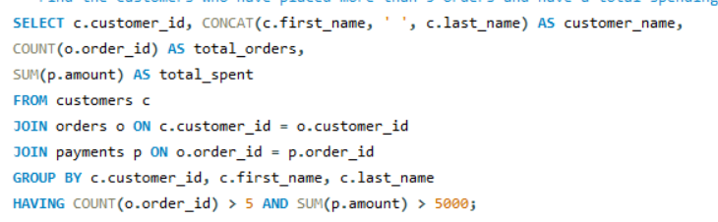
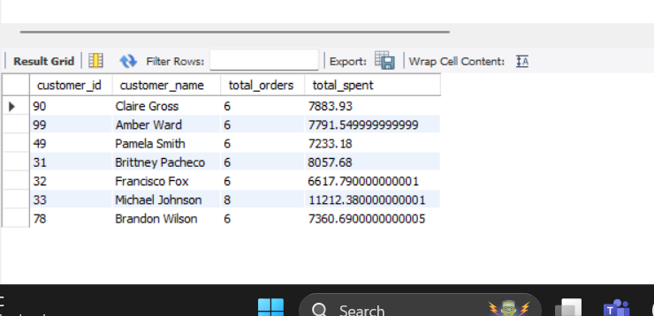
07.
Find the customers who have placed more than 5 orders and have a total spending of over 5000.

Slide 10
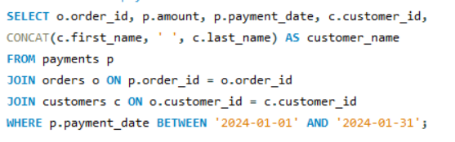
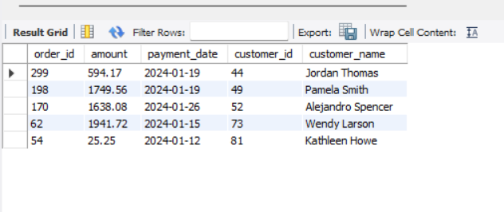
08.
Retrieve all payments made within '2024-01-01' and '2024-01-31', along with the corresponding order and customer details.

Slide 11
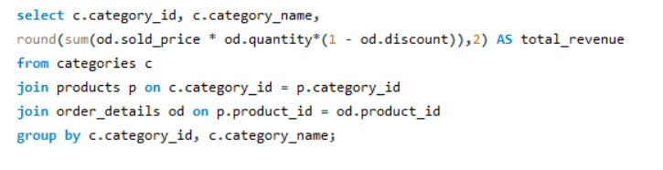





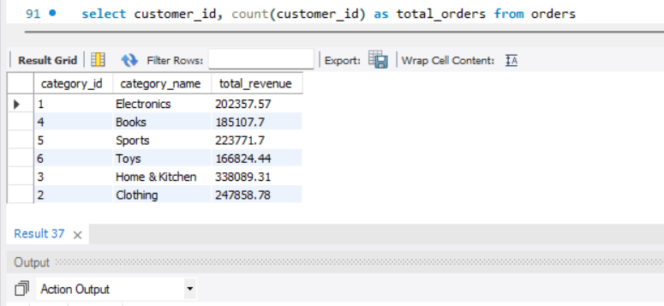

Total Sales for each Category

Slide 12

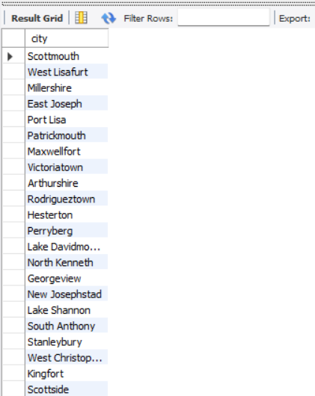
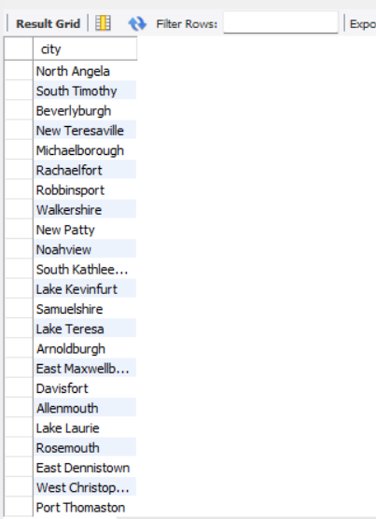
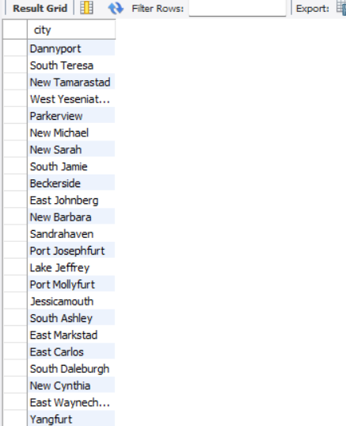
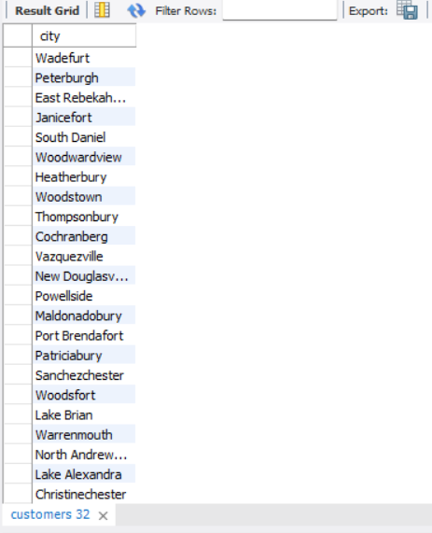

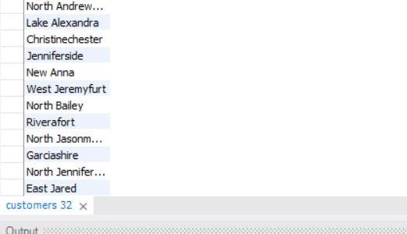
Customers availavle in :
Available

Slide 13

Importance of Analysis
The insights derived from these queries are crucial for making data-driven decisions in the retail environment. Understanding customer preferences allows the store to tailor marketing efforts and personalize offers, ultimately enhancing customer satisfaction and loyalty. Analyzing product sales and stock levels helps in optimizing inventory management, ensuring that popular items are always in stock while reducing the carrying cost of less popular items. The breakdown of payment methods provides a clearer picture of customer preferences, enabling the store to refine its payment options and potentially introduce new ones to improve the shopping experience.

Slide 14

Future Implications for the
Retail Store
The findings from this analysis can guide future strategic decisions in several ways. By focusing on top customers, the store can implement loyalty programs that reward frequent buyers, driving repeat business. The product sales and stock data can inform purchasing strategies, ensuring that the right products are stocked at the right levels, reducing both out-of-stock situations and excess inventory. Additionally, understanding the seasonal trends in revenue can help the store plan promotions and sales events at optimal times, maximizing revenue. Overall, this analysis lays the groundwork for a more efficient, customer-focused retail operation that is better equipped to adapt to market changes and consumer demands.

Slide 15

Explore more queries on my GitHub Repository

